Slide 1


Slide 2
Web Technologies and Programming
Lecture 19

Slide 3
Summary of Previous Lecture
Dialog boxes in JavaScript
Alert box
Prompt box
Confirm box
What is DOM?
HTML DOM
Retrieving HTML elements
getElementById()
innerHTML
getAttribute()
setAttribute()

Slide 4
Summary of Previous Lecture
HTML DOM Elements
Finding HTML Elements
Find an element by element
Find elements by tag
Find elements by class name

Slide 5
Today’s Lecture Outline
Controlling the background dynamically
Working with images
Date Object

Slide 6
1. Controlling the background
The body tag has the following attributes
Bgcolor
It is Background Color
Background
It deals with the Background Image
Text
It is the text user sees in the browser

Slide 7
1.1 Setting the bgcolor
We can access the bgcolor by following methods:
document.body.bgColor
document.getElementById(“id of the body tag”).bgColor

Slide 8
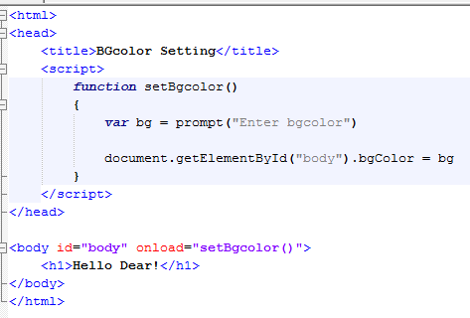
1.1 Setting the bgcolor…
Starting Function
User Input
Setting bgcolor
Calling Function

Slide 9
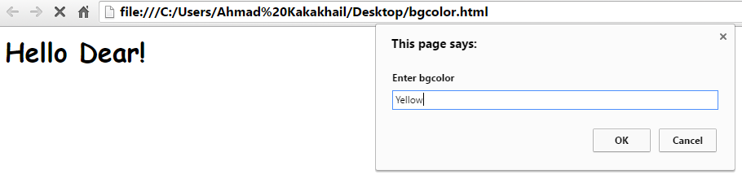
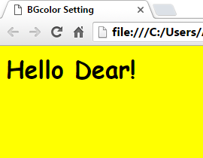
1.1 Setting the bgcolor…
User Inputs bgcolor in Prompt Box
After Applying bgcolor

Slide 10
1.2 Setting the text color
Set a background color for a document:
We can access the body text by following methods:
document.body.style.color
document.getElementById(“id of the body tag”).style.color

Slide 11
1.2 Setting the text color
Example
Set a background color of a specific <div> element:
document.getElementById("myDiv").style.backgroundColor = "lightblue";

Slide 12
1.2 Setting the text color
Example
Return the background color of a specific <div> element:
alert(document.getElementById("myDiv").style.backgroundColor);
Example
Return the background color of a document:
alert(document.body.style.backgroundColor);

Slide 13
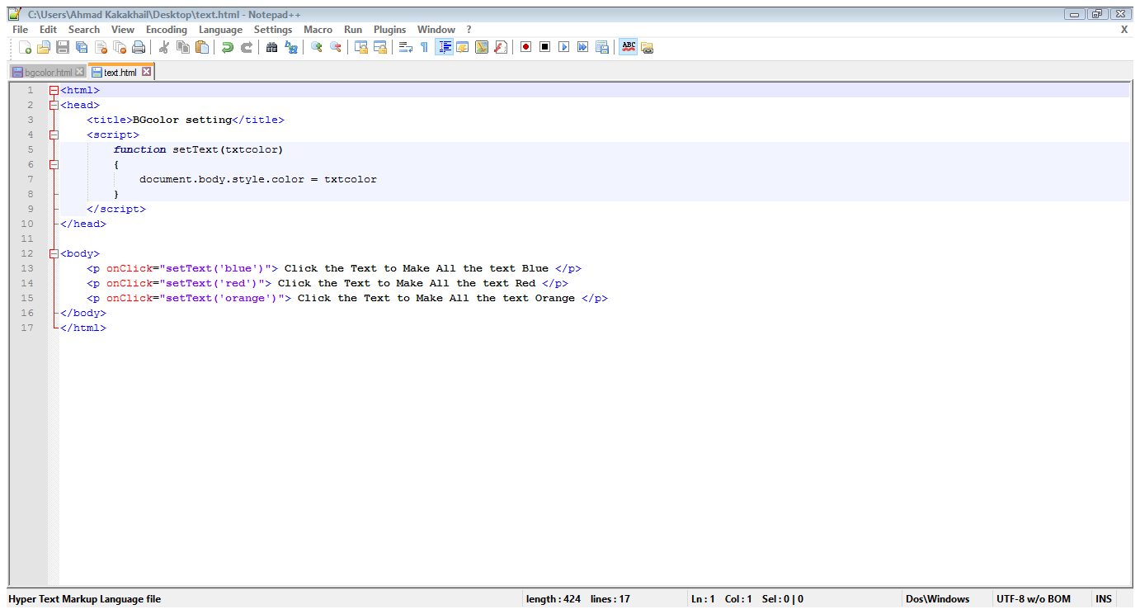
1.2 Setting the text color…
Set Text Function
Setting Color
Calling Function
Passing Color as Parameter

Slide 14
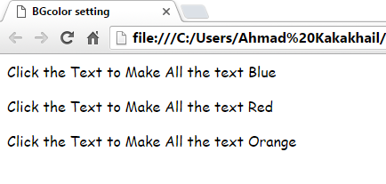
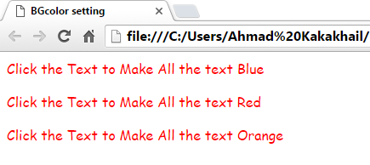
1.2 Setting the text color…
Before Clicking on Text
After Clicking on Text for Red Color

Slide 15
1.3 Setting the background
The background property sets or returns up to eight separate background properties, in a shorthand form.
With this property, you can set/return one or more of the following (in any order):
background-color
background-image
background-repeat
background-attachment
background-position
background-size
background-origin
background-clip

Slide 16
1.3 Setting the background
Example
Set a background color for a document:
document.body.style.backgroundColor = "red";
Example
Set a background image for a document:
document.body.style.backgroundImage = "url('img_tree.png')";

Slide 17
1.3 Setting the background
Example
Set a background-image to no-repeat:
document.body.style.backgroundRepeat = "repeat-y";
Example
Set the background-image to be fixed (will not scroll):
document.body.style.backgroundAttachment = "fixed";

Slide 18
1.3 Setting the background
Example
Change the position of a background-image:
document.body.style.backgroundPosition = "top right";

Slide 19
1.3 Setting the background
We can access the background by following methods:
document.body.background
document.getElementById(“id of the body tag”).background

Slide 20
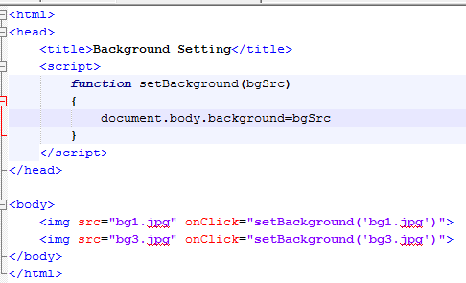
1.3 Setting background…
Function for Receiving Src
Setting Background
Function Call
Src Passed
Image Added

Slide 21
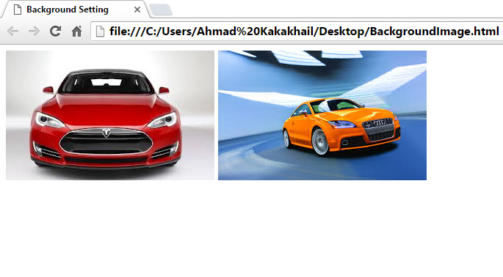
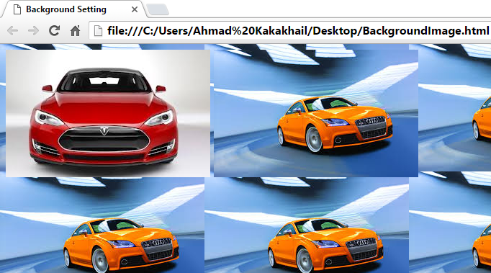
1.3 Setting background…
Before Clicking on Image
After Clicking on Image

Slide 22
2. Working with images
JavaScript has a built-in object called Image
The Image object allows you to create objects that represent images created using the <img> element
Properties: name, border, height, width, hspace, vspace, src

Slide 23
2. Working with images…
An image object can be created as
var objname= new image()
The most important property of an image object is src
This designates the actual image file you will use as a source for your Image object
objname.src= “abc.jpg”
This property can be used to dynamically change an image on the webpage

Slide 24
2. Working with images….
The primary use for an Image object is to download an image into the cache before it is actually needed for display
Instance of image object is created
Src property is set to the name of the image to be downloaded

Slide 25
2. Working with images….
Image Object
The Image object represents an HTML <img> element.
Access an Image Object
You can access an <img> element by using getElementById():

Slide 26
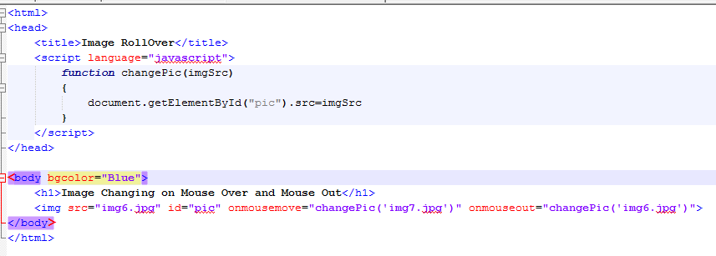
2.1 Image MouseMove and MouseOut Function
Function Start
Setting Image Src
Image Addition
Calling MouseOver Function
Calling MouseOut Function

Slide 27
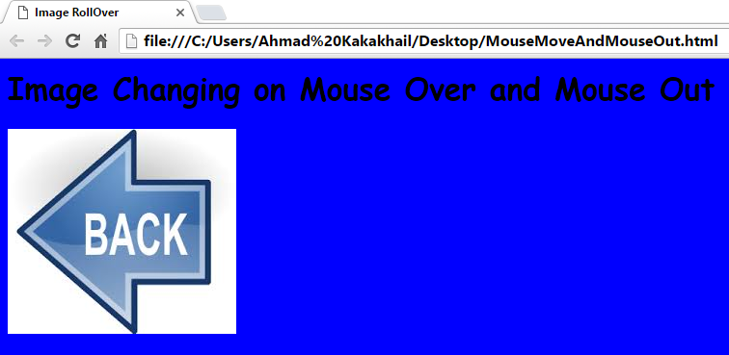
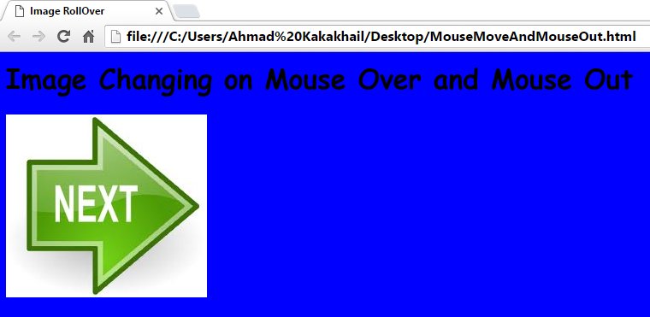
2.1 Image MouseMove and MouseOut Function…
On MouseOut
On MouseOver

Slide 28
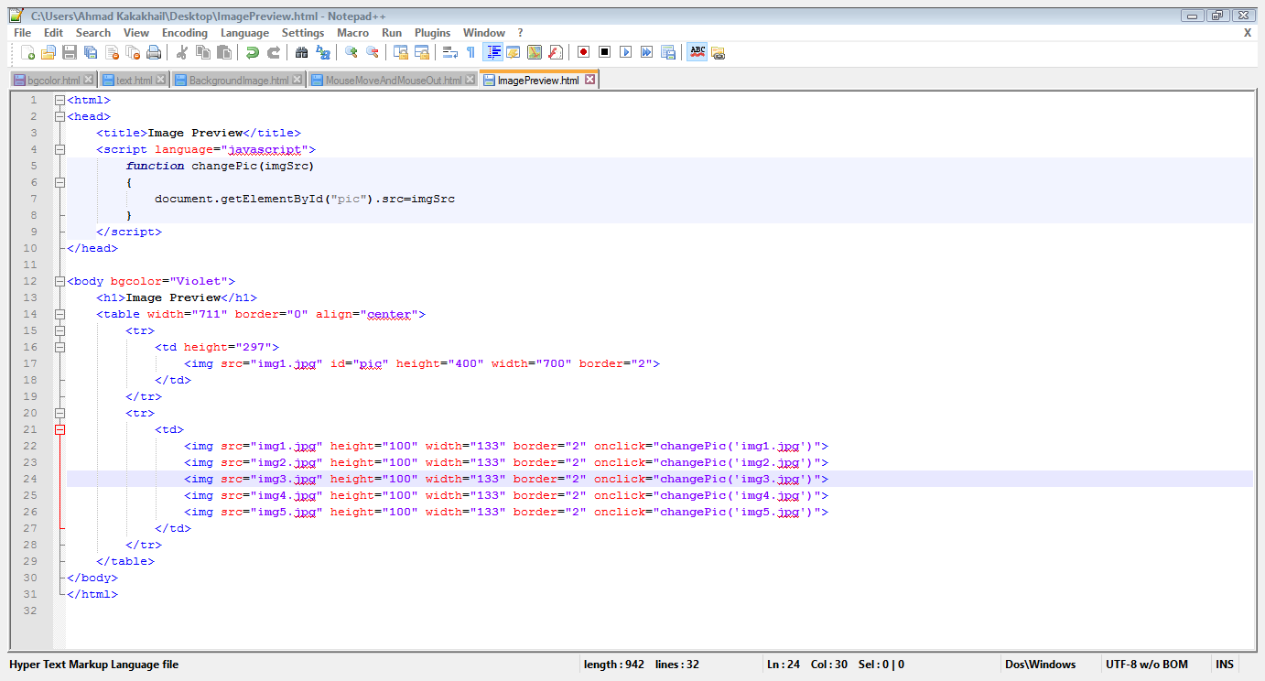
2.2 Image Preview
Src Passed
Main Image
Function Call
Image Src
Small Images

Slide 29
2.2 Image Preview…
Function Gets Src
Main Image Src Changed

Slide 30
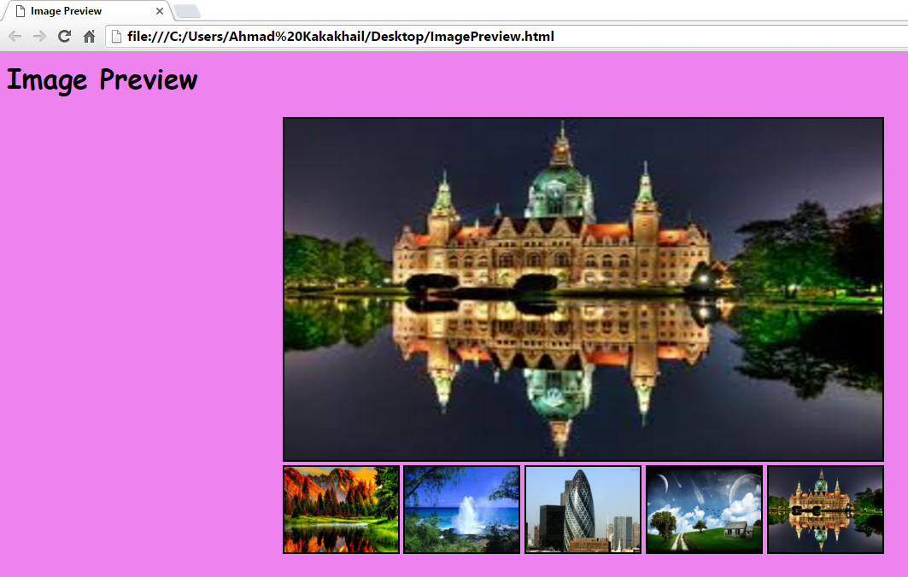
2.2 Image Preview…
On Page Load

Slide 31
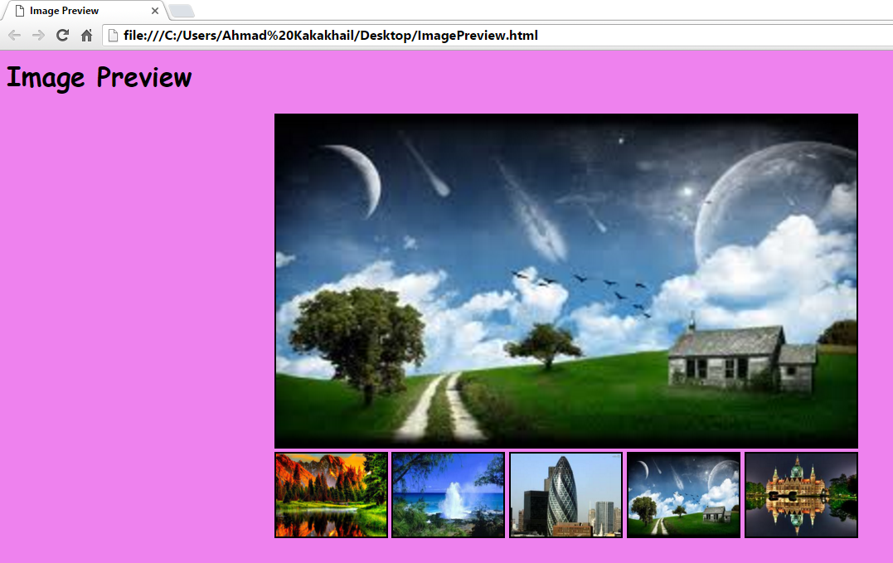
2.2 Image Preview…
After Changing Source

Slide 32
2.3 Slide Show
Array of images
Main image
Next and previous image buttons
Next image and previous image functions

Slide 33
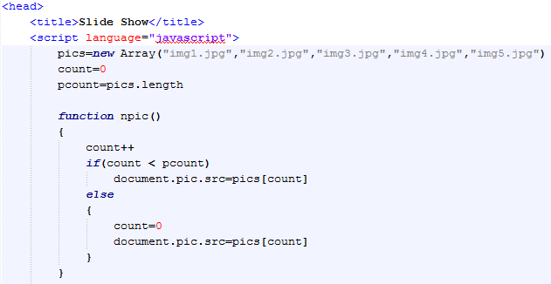
2.3 Slide Show…
Array of Images
Length of Pics Array
Increases Pics Index
Checks for Last Image
Next Pic
Set count to zero incase of last image
Changes the Image

Slide 34
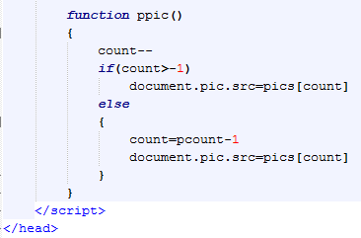
2.3 Slide Show…
Count Decrement
Checks for First Image
Changes The Image
Sets Count incase of First Image

Slide 35
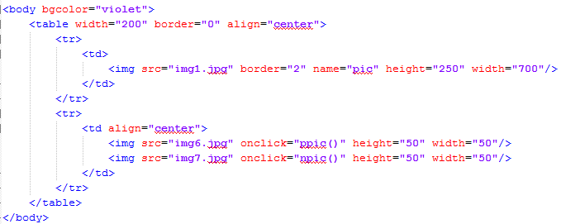
2.3 Slide Show…
Main
Image
Call to Previous Pic Function
Back Image
Next Image
Call to Next Pic Function

Slide 36
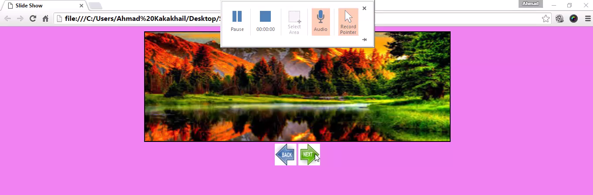
2.3 Slide Show…

Slide 37
2.4 Slide Show (with Self Changing Images)
Array of images
Main image
Next image function

Slide 38
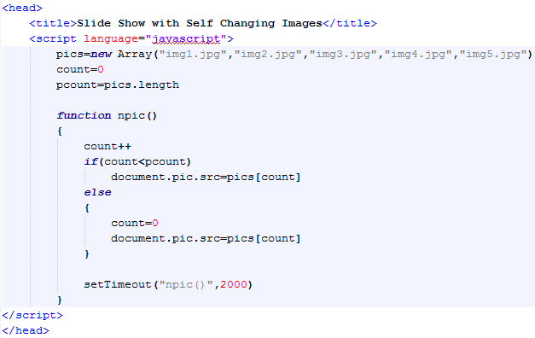
2.4 Slide Show (with Self Changing Images)…
Image Array
Increment the count
Checks for the last image
Image changes
Set Count to Zero incase of Last Image
Time Based Function Call

Slide 39
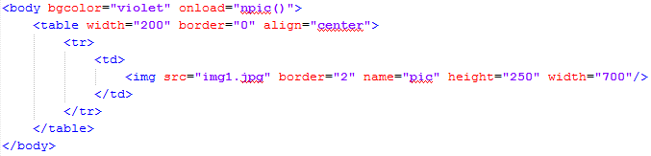
2.4 Slide Show (with Self Changing Images)…
Next Pic Function Call
Main Image

Slide 40
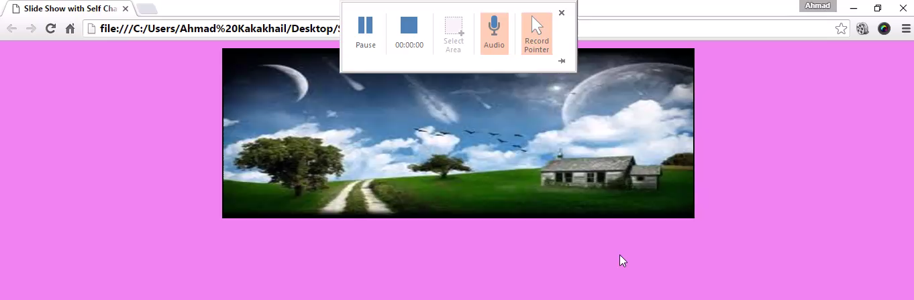
2.4 Slide Show (with Self Changing Images)…

Slide 41
3. Working with date object
The Date Object is used to work with dates and times
It can be used to find the Current Time and Date
Many time based tasks can be performed
Date objects are created as
var today=new Date()

Slide 42
3. Working with date object…
Date object methods:
getDate():
Returns the day of the month (from 1-31)
getDay():
Returns the day of the week (from 0-6)
getFullYear():
Returns the year (four digits)
getMonth():
Returns the month (from 0-11)

Slide 43
3. Working with date object…
getHours():
Returns the hour (from 0-23)
getMilliseconds():
Returns the milliseconds (from 0-999)
getMinutes():
Returns the minutes (from 0-59)
getSeconds():
Returns the seconds (from 0-59)

Slide 44
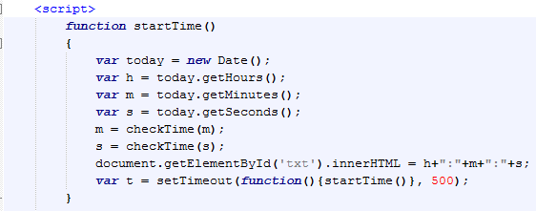
3.1 Digital clock
Date Object is Created
Gets Hours
Gets Minutes
Gets Seconds
Calls Check-Time Function
Self Function Call
Writes Time on txt Div

Slide 45
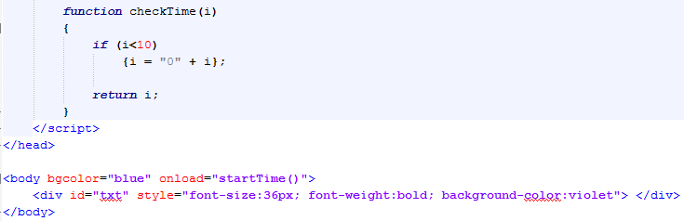
3. Working with date object…
Concatenate ‘0’ If Time is Less Than 10
Start Time Function Call
Empty div to Display Time

Slide 46
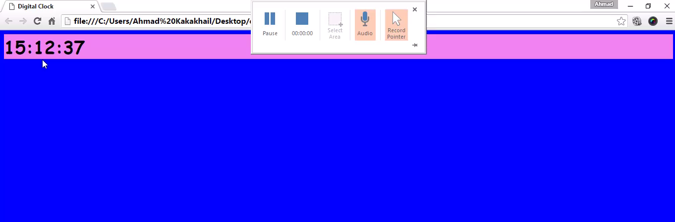
3. Working with date object…

Slide 47
Summary of Today’s Lecture
Controlling the background dynamically
Bgcolor
SET For a document
SET For a specific <div>
SET the Text Color
Return background color of a specific <div> element
Return background color of a document:
Background
background color for a document
background image for a document
Set a background-image to no-repeat
Set the background-image to be fixed
Change the position of a background-image

Slide 48
Summary of Today’s Lecture
Working with images
Access an Image Object
On MouseOut
On MouseOver
Image Rollover
Image Preview
Image Slide Show
Date object
Digital Clock

Slide 49
THANK YOU

